Slide 1

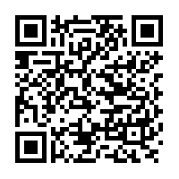

Visit the Website:
awayteam.redshrt.com
Away Team
Android App
on the Play Store!
Notes:
Encourage viewers to visit the website and/or download the app so that they can participate in the presentation. Reminder that contact information is displayed, so entering inaccurate contact info is fine, but for the demonstration, it would be really cool if everyone used their real names.

Slide 2
A Mobile Productivity
&
Team Coordination Tool
Created by Team 3
Steve Naimoli, Peter Karski, David Vu, Clay Parker
Notes:
Welcome: Final Presentation for Away Team

Slide 3

Project Goals
Provide a tool for mobile professionals who must coordinate with a team on the road.
Scenario:
You are tasked to travel with a team of colleagues and you need a tool to easily share task information.
You want something that will allow you to access your teammates’ contact information, coordinate schedules, track completion of trip goals and tasks, and compile an expense report for your return to the home office.
Notes:
The purpose of Away Team is to provide users with a collection of collaborative tools to manage groups of people with shared goals. These tools are packaged in a way that a mobile professional trying to coordinate a work trip with colleagues would find the task easier using the app.
Provide Scenario overview.

Slide 4
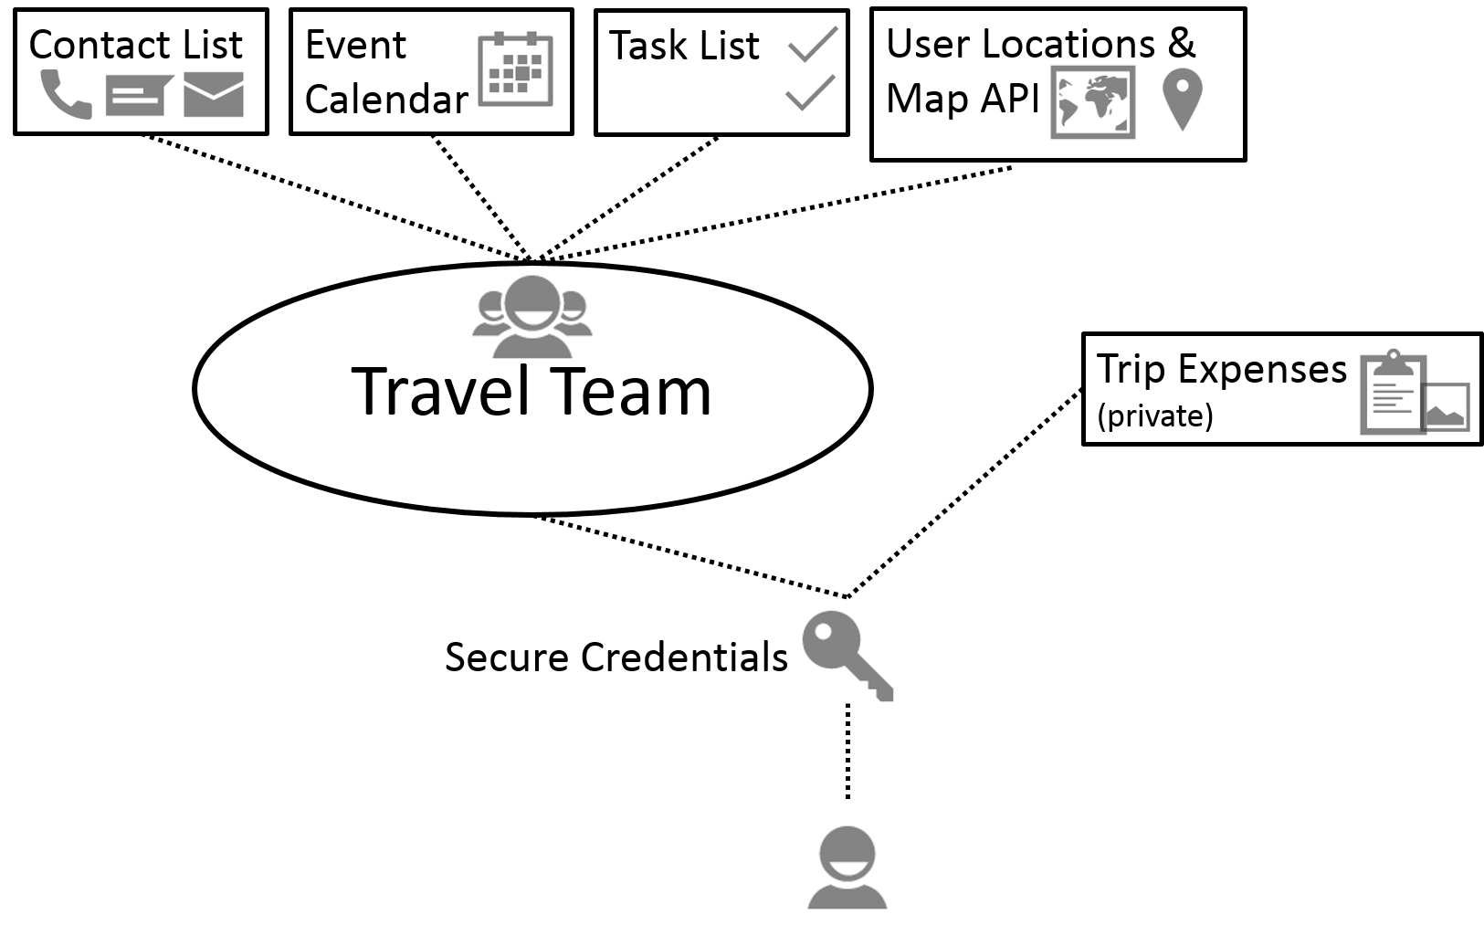
Key Features
Multi-Platform
Web Client
Android Application
Mobility
Android Integration
Integrated Geo-Tracking
Team Coordination
Manage Multiple Teams
Share Contacts, Events, Tasks
Track Expenses
Security
SSL implemented and using TTL on all authenticated transactions
Built-in authentication processes on transactions
Notes:
The key features provided by Away Team are:
-The ability to access the system from a range of devices, from mobile Android phones through the app or on computers or non-android devices using the web client.
-The app was designed with mobility in mind, so mobile concepts like geo-tracking are included to provide information relevant to the user’s location.
-The coordination tools that are designed to help the mobile professional include managing multiple teams, group contact sharing, sharing events and tasks, and the ability to track expenses to assist in making trip expense reports.
- Since the app deals with user’s contact information, the communications are conducted entirely using TTL and the team designed a strong authentication process to identify users and ensure that actions in the system cannot be spoofed.

Slide 5
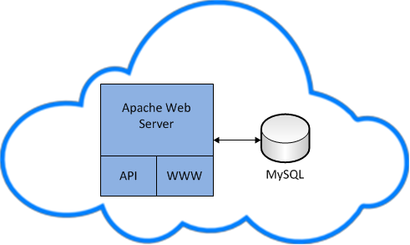
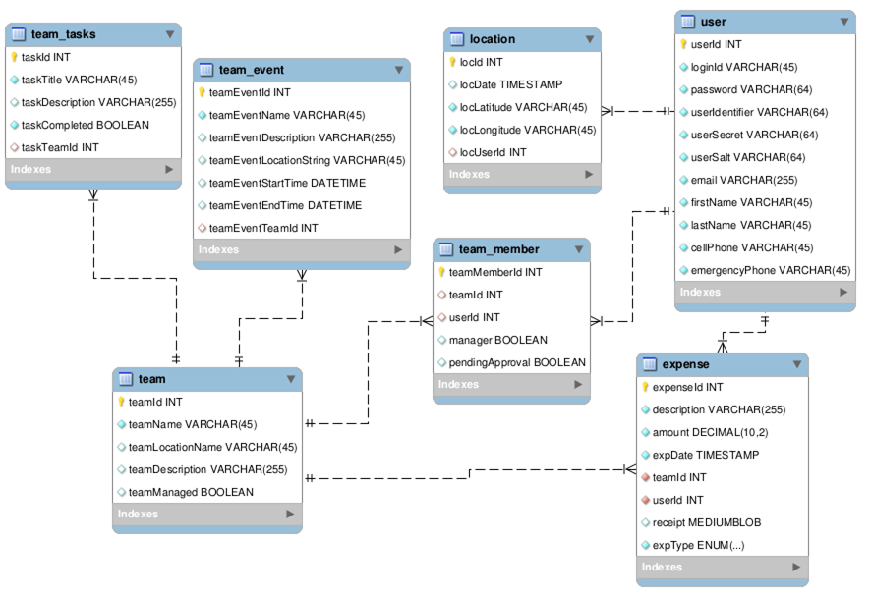
Design Overview
Clients:
Android
Web
Server:
REST API over PHP (SSL)
Apache web server (SSL)
Database:
MySQL
Notes:
This is the big-picture design of the Away Team system.
We store the team information in a MySQL server, which is accessed by Android and Web clients through an Apache web server implementing REST API.

Slide 6
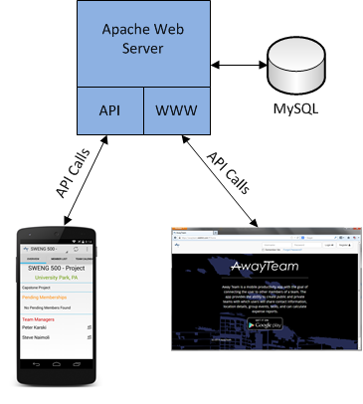
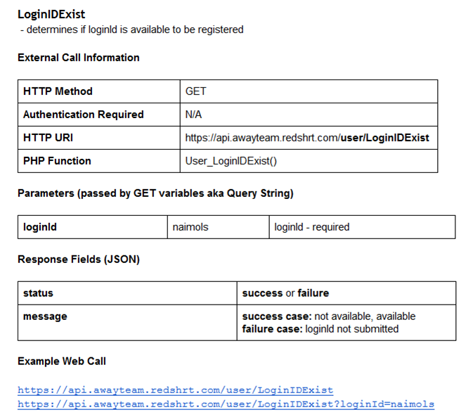
API Design Overview
RESTful API
Sessionless & Stateless Comms
POST and JSON data implemented
POST - input
JSON - output
Both clients utilize same API calls
Example API Documentation

Slide 7
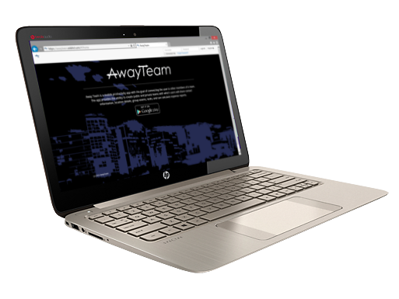

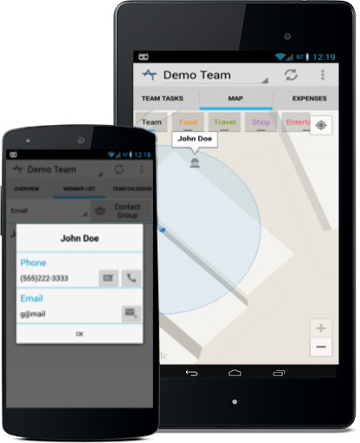

Features: Multi-Client
Notes:
A key strength of the system is the fact that it can be accessed from practically any internet-capable mobile or computing device. As we discuss the features of the system in more depth, we will highlight the web-browser and android features.

Slide 8
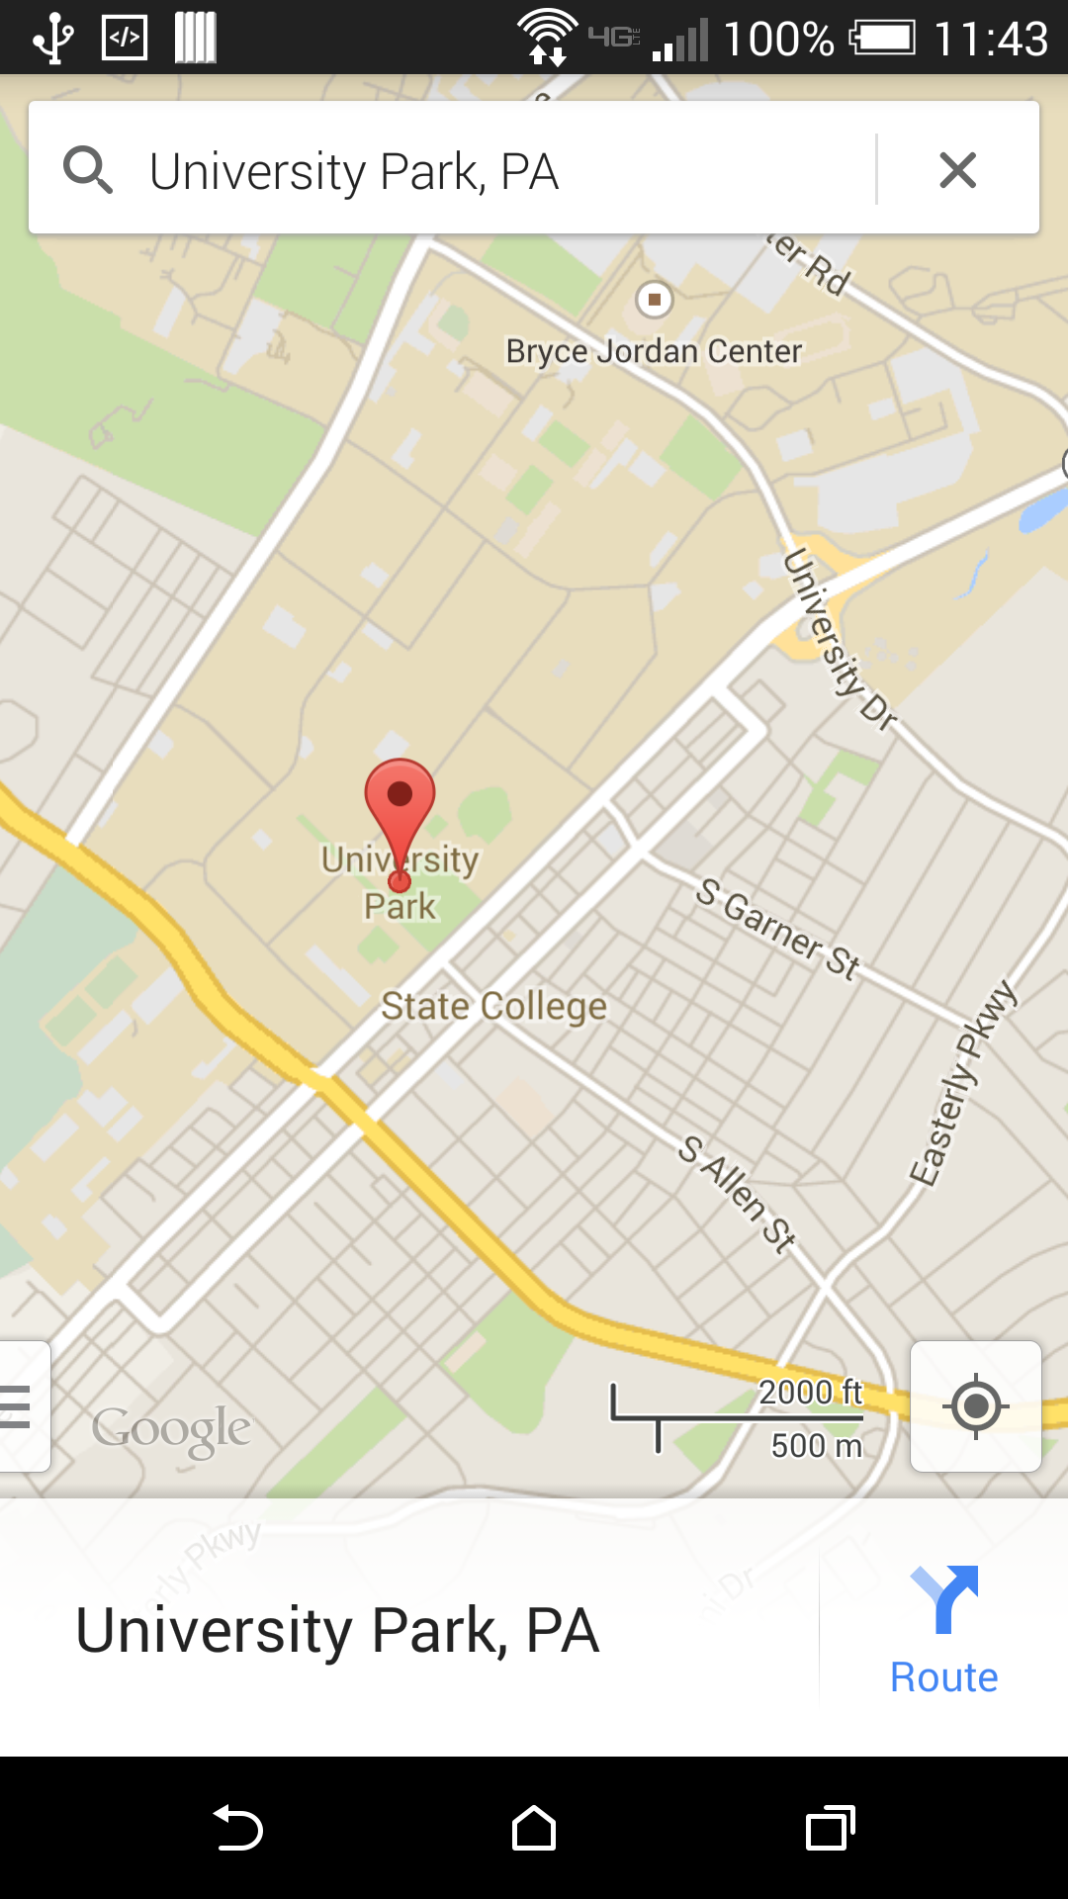
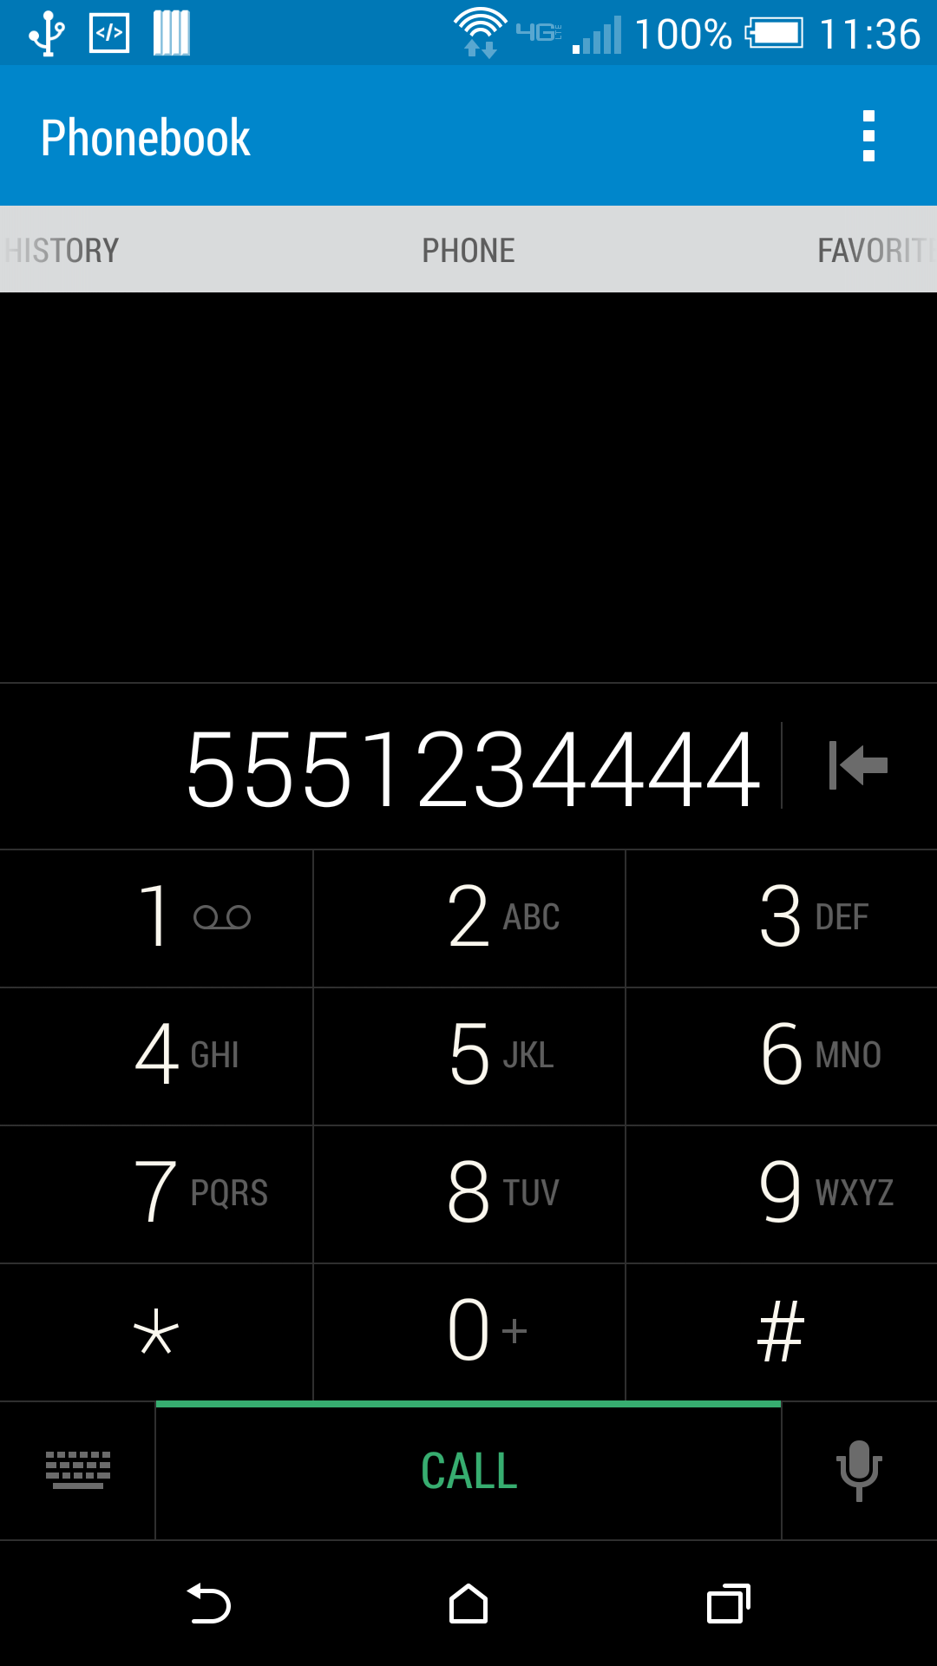
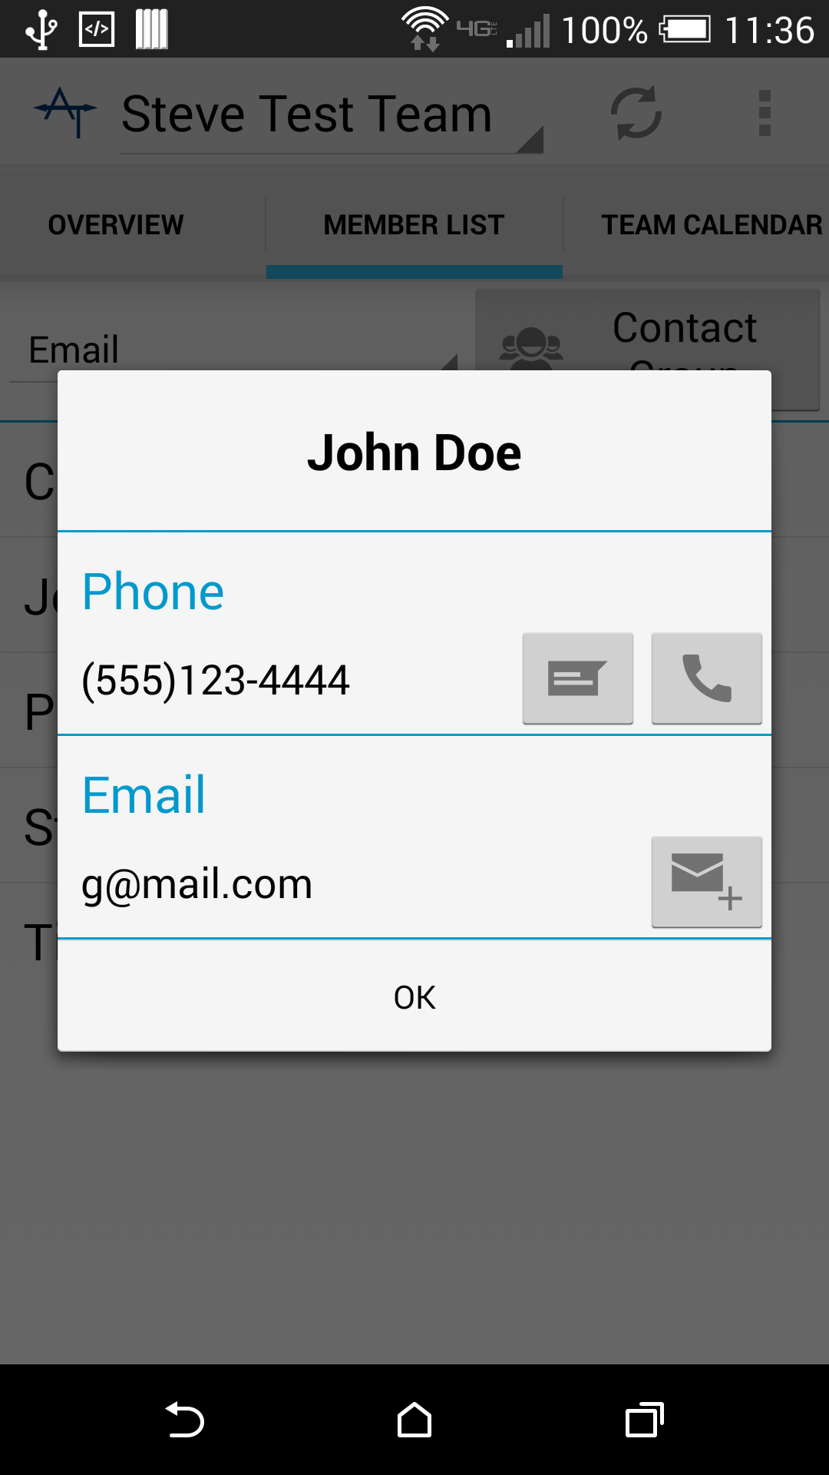
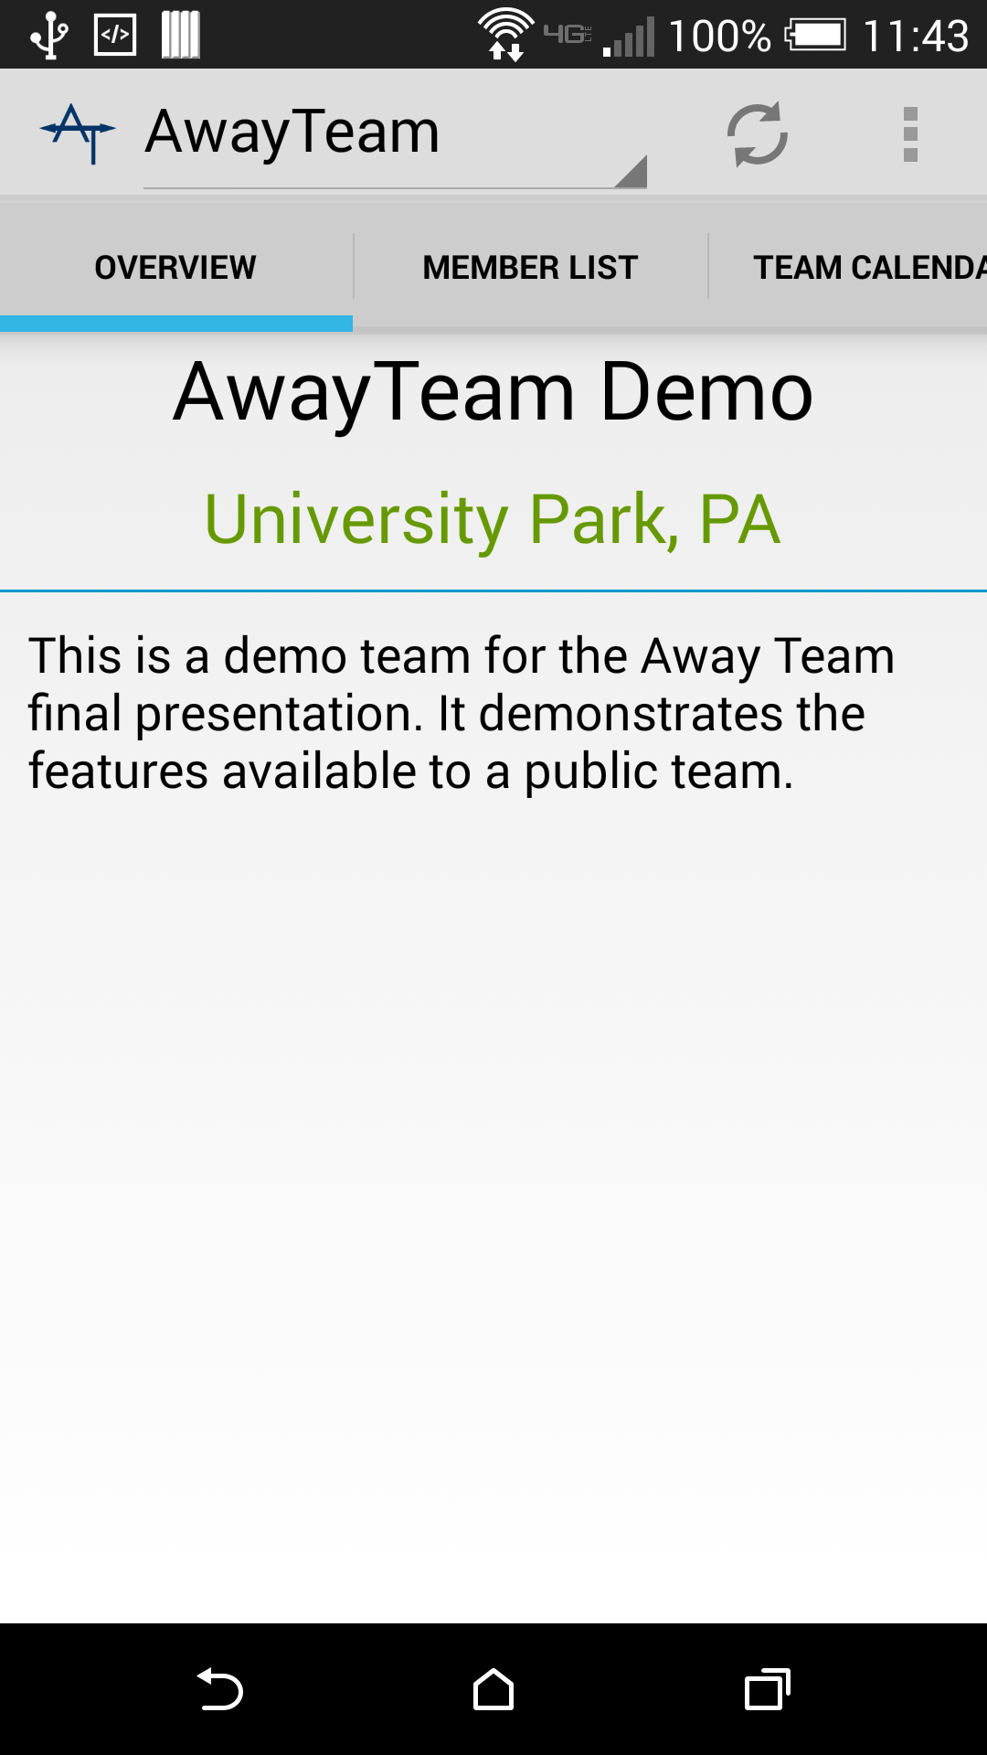
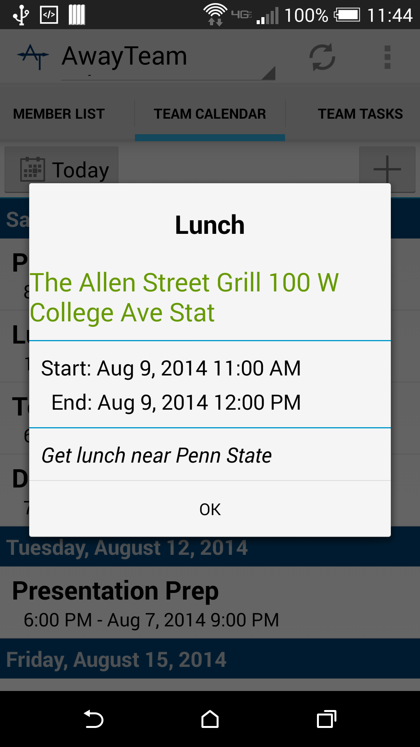
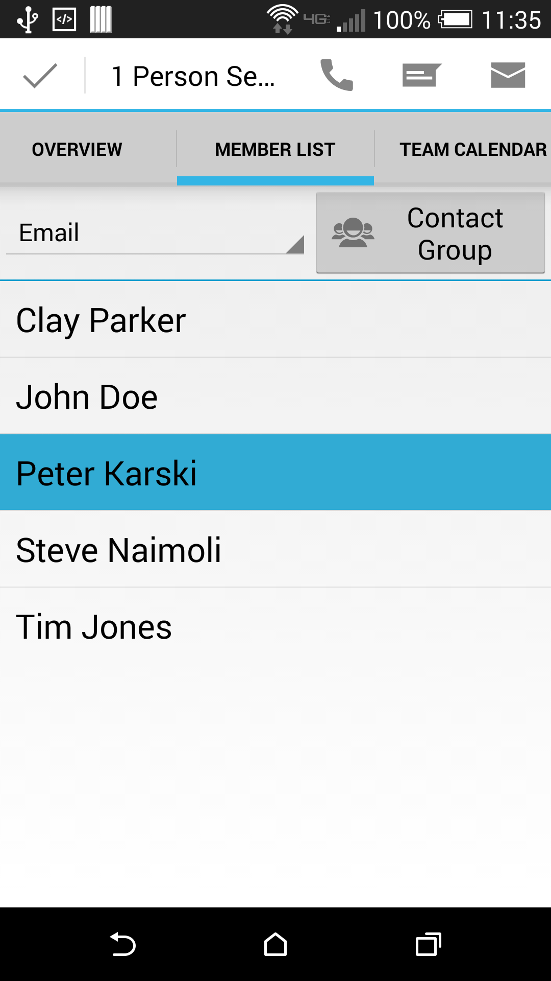
Features: Android Integration
Green Text opens Maps client
Use preferred map tool to view location and get directions!
Contacts open Local Communication Tools
Use apps installed on phone for email, text, and phone calls
(allows flexible VOIP or internet text selections)
Notes:
One great aspect about designing for Android is the ability to take advantage of the Android framework to integrate into the apps the user already uses and is comfortable with.
(click)
Throughout the Android app, you will see green text, this indicates location data that can be opened in your map application for more detailed information, directions and so-on.
(click)
Contact operations, whether call, email, or sms, will automatically launch the apps the user has on their phone. In this example, the number opens in the Android dialer, but if the user had a VOIP app that they preferred to use for phone calls - for example, if they were traveling internationally and wanted to avoid the long-distance charges, it would offer the installed VOIP app as an option to complete the action with.

Slide 9
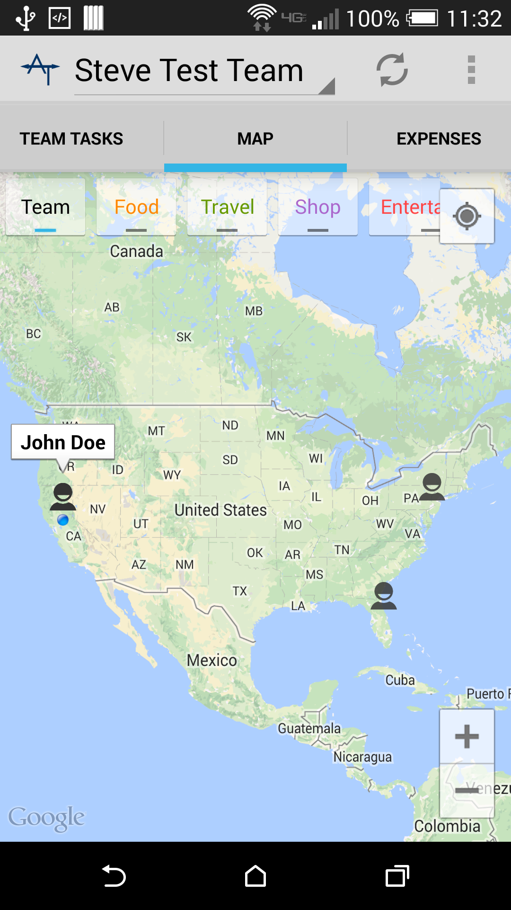
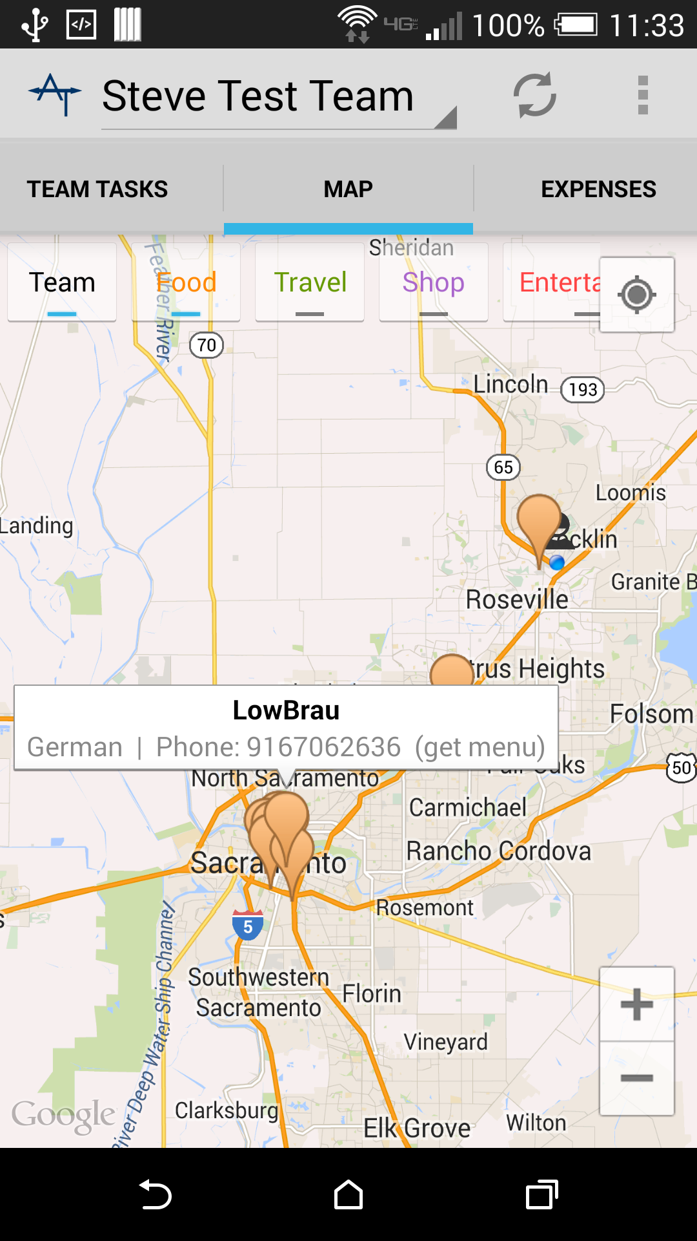
Features: Geo-Tracking
Find team members’ location
Useful for seeing when everyone has arrived at the airport or finding a meeting location
Get Contact Info for team members near you
Find locations of interest nearby
App collects recommendations from FourSquare to present nearby suggestions
Notes:
Since the app is designed around travel, including location-based information was a key feature the team wanted.
(click)
The app provides a map interface with various overlay options. One can show the last reported location of team members. This can be used to find out who is in the area, providing contact information through the name popup, making it easy to call and set up appointments or meetings with team members who are nearby.
(click)
The app also incorporates information from FourSquare to provide useful suggestions for places to go in an unfamiliar location. Helpful if you are on a trip and want to look at menus for nearby restaurants.

Slide 10
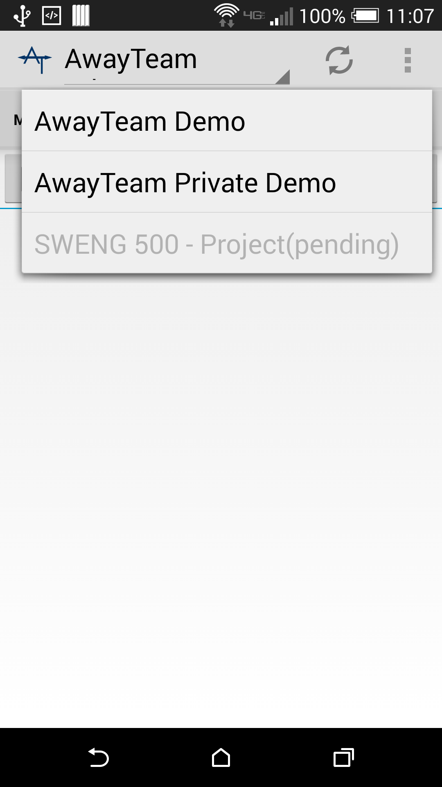
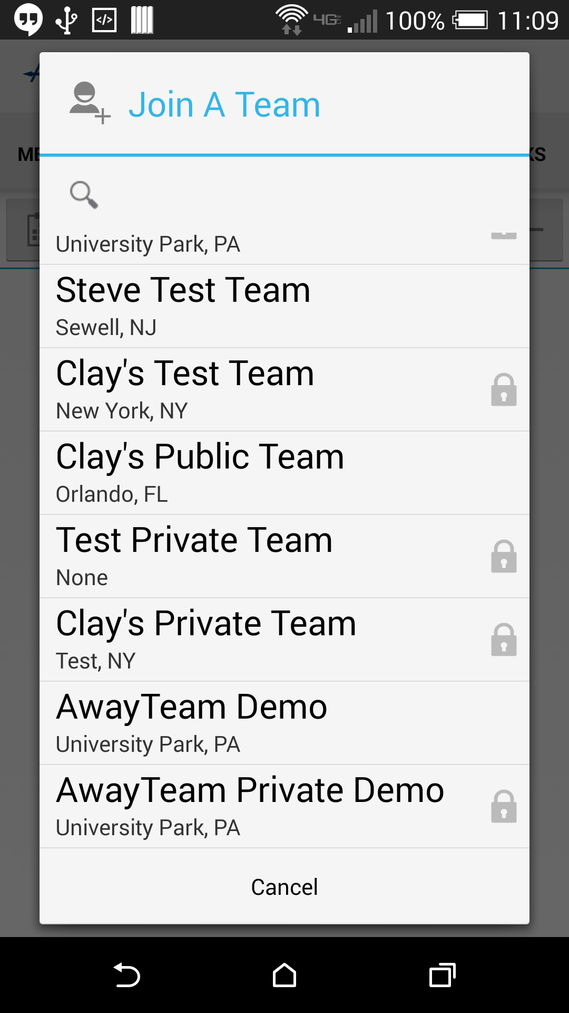
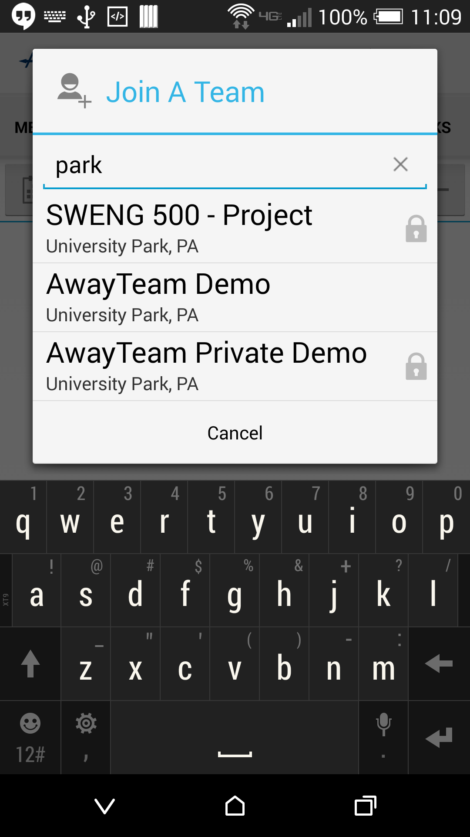
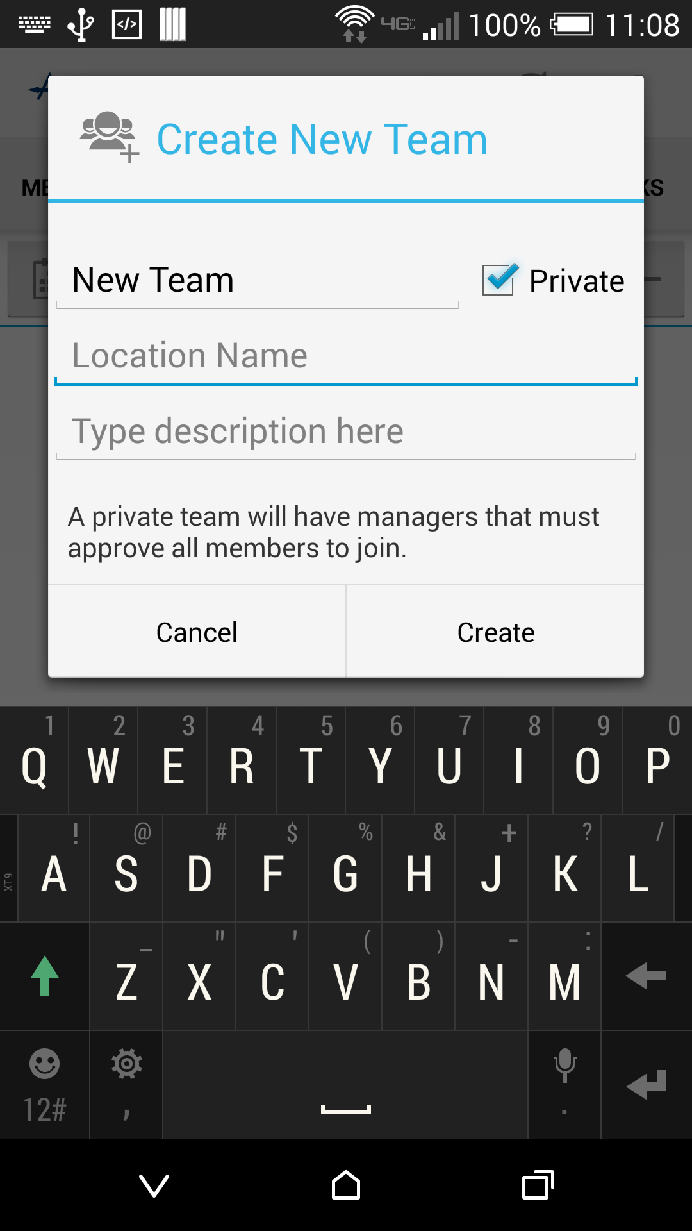
Features: Multiple Teams
Join Pre-Built Teams
Search filters by team name and location
Create Your Own Team
Remember that each joining member needs permission in a Private Team
Switch Between Teams
Requested membership to a private team is not selectable until approved
Notes:
Away Team is designed around the idea of a team - a team is a group of people that have some common goal or need to share information. To keep the system flexible, any user can belong to several teams at once and freely switch between them.
(click)
Users can join teams by selecting the menu option - there are public teams, which anyone can join immediately, and private teams, indicated by a lock that require permission from a team manager to join. Selecting a private team will place a request that the manager can see.
(click)
You can also create your own teams - if it is private, the creator will become the manager of the team. They will grant or deny permission for new members to join and can promote other managers to help them out.
(click)
Switching between teams you are a member of is accomplished simply by clicking on the team name dropdown at the top of the app window. Private teams that membership has been requested for, but not granted yet show up grey.

Slide 11
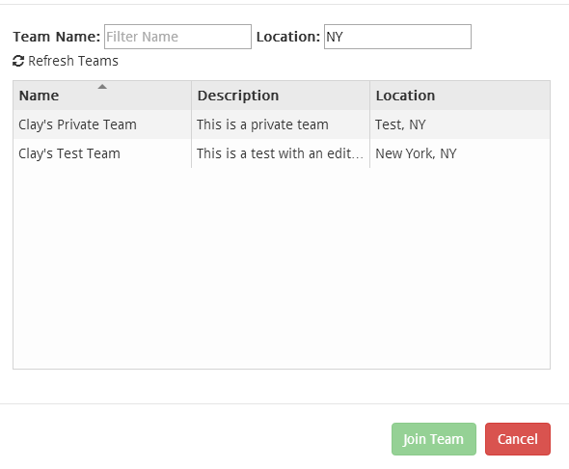
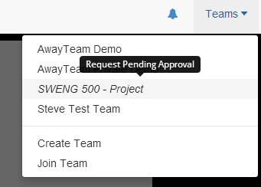
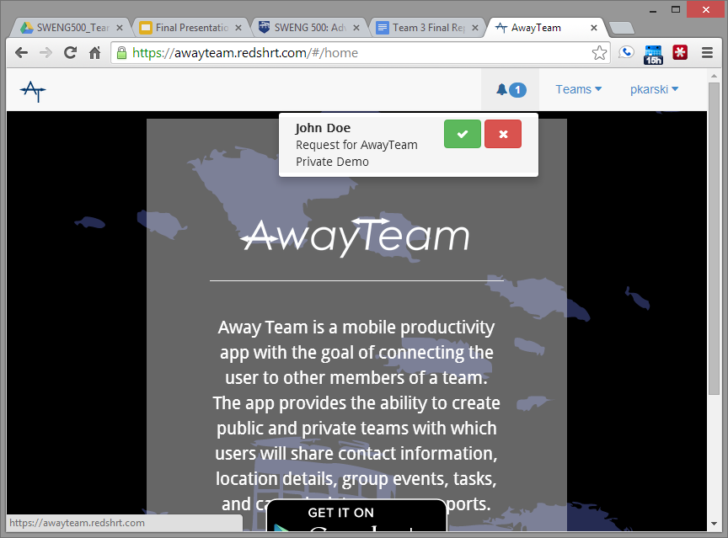
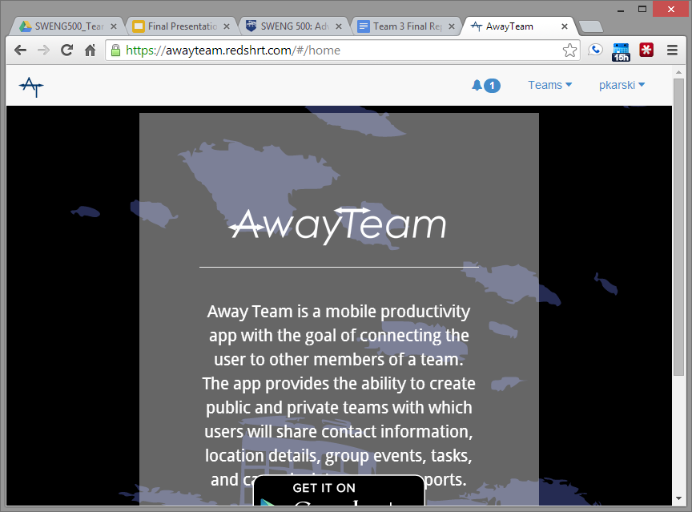
Features: Multiple Teams
Manager Notifications
View and take action on all team membership requests in one place!
Switch Between Teams
Requested membership to a private team is not selectable until approved
Join Pre-Built Teams
Search filters by team name and location
Notes:
The web application has the same functionality as the app, but the interface is tailored for a web browser.
(click)
Joining a team is displayed in a sortable table.
(click)
When a user requests membership to a private team, the manager receives a notification in their interface that allows them to see all the requests for each team they manage and take action right from the notification.
(click)
Just like the app, a dropdown shows teams the user can switch to and pending memberships are non-selectable.

Slide 12
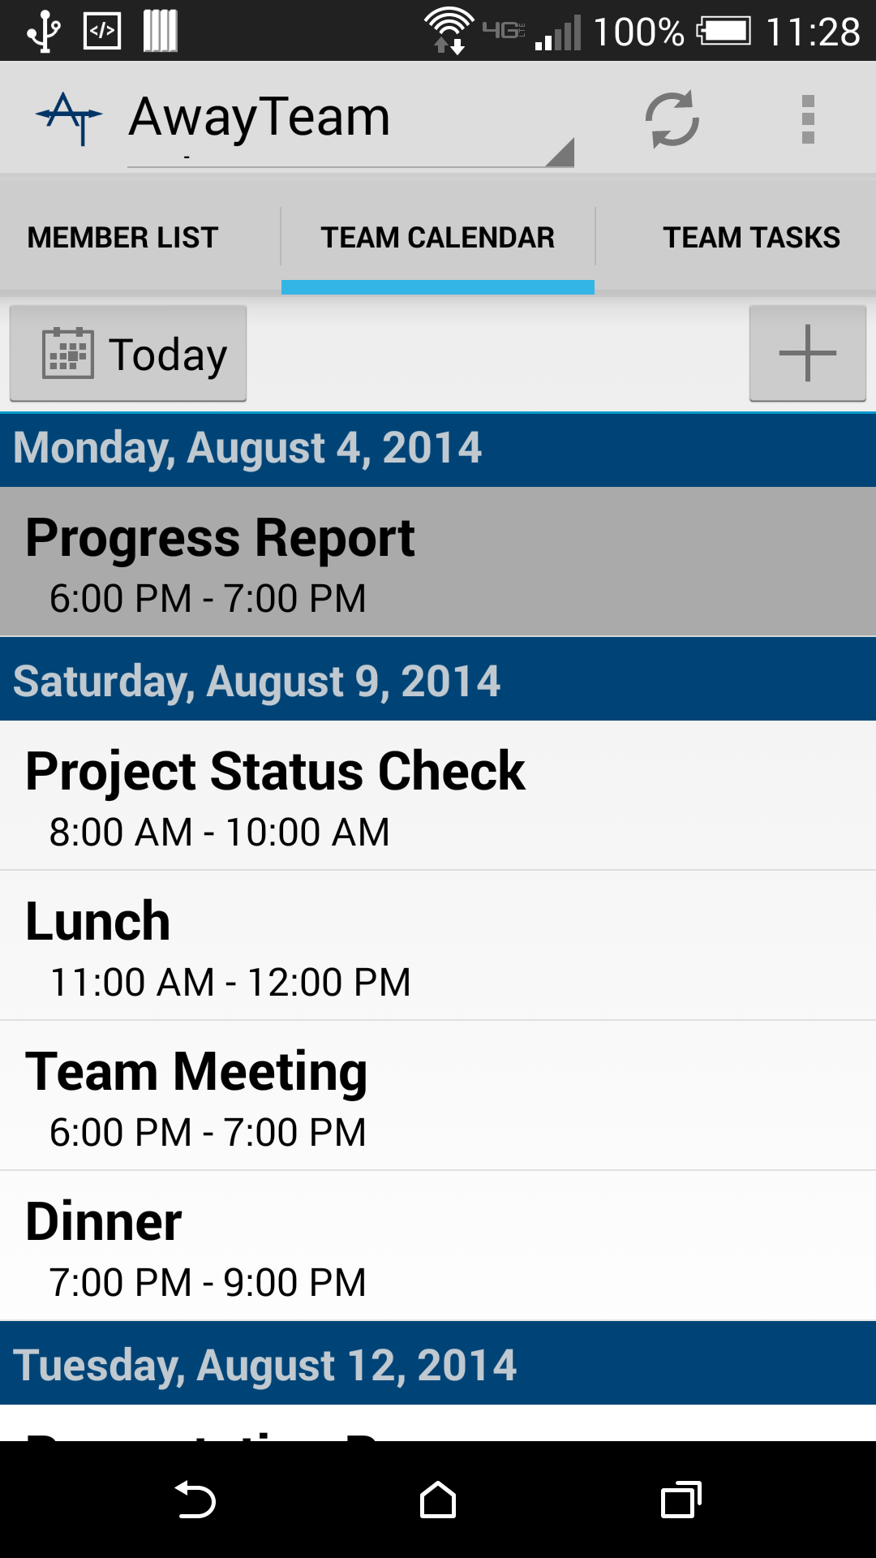
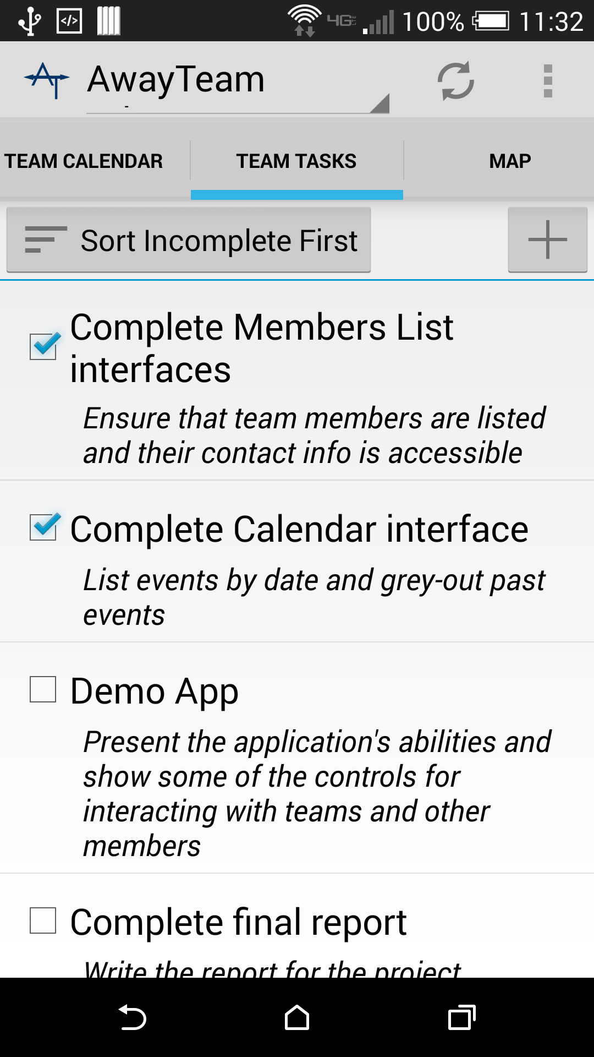
Features: Coordination Tools
Team Contacts
Find Team contact information in one place
Easy group contact options
Team Agenda
View scheduled events and details
Get directions using location
Team Tasks
Shared list of tasks to accomplish
Track progress on team goals
Notes:
The central functionality of Away Team is the ability to coordinate and share information with your team.
(click)
The Member List shows all the team members and a variety of contact options, including a button to contact the entire group with one click.
(click)
The Calendar shows an agenda of events and provides a shared schedule for the team. Details can be added, along with locations for directions.
(click)
Tasks provides a “todo list” of goals for the team to complete. Anyone can mark tasks complete with the check mark as they accomplish them.

Slide 13
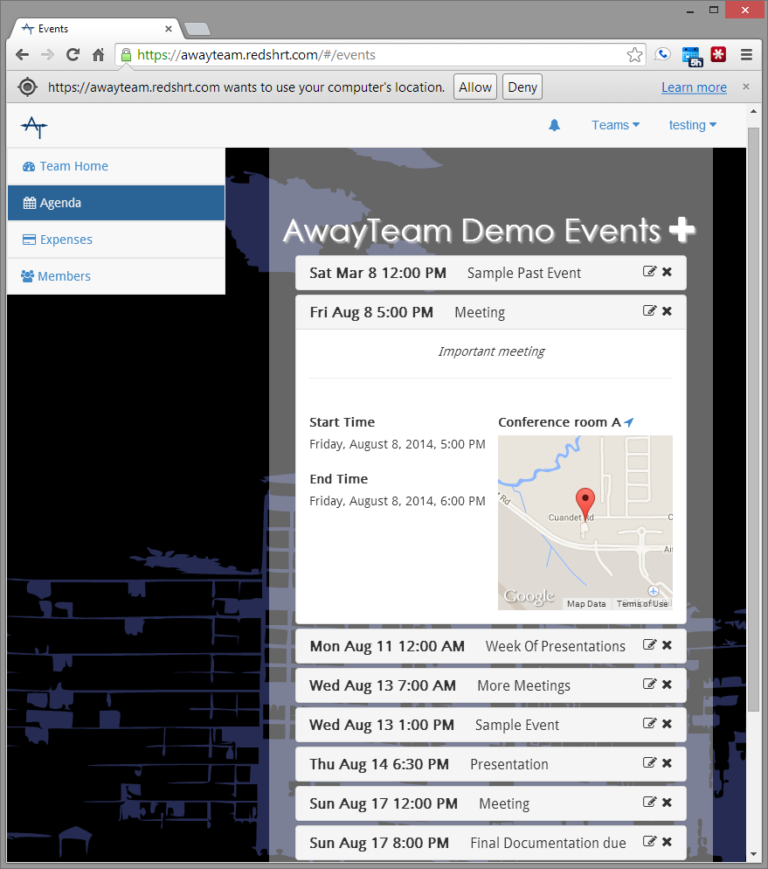
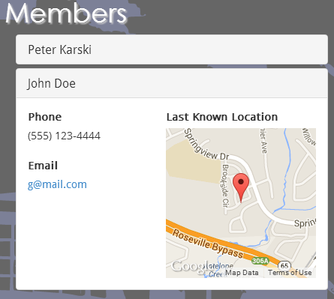
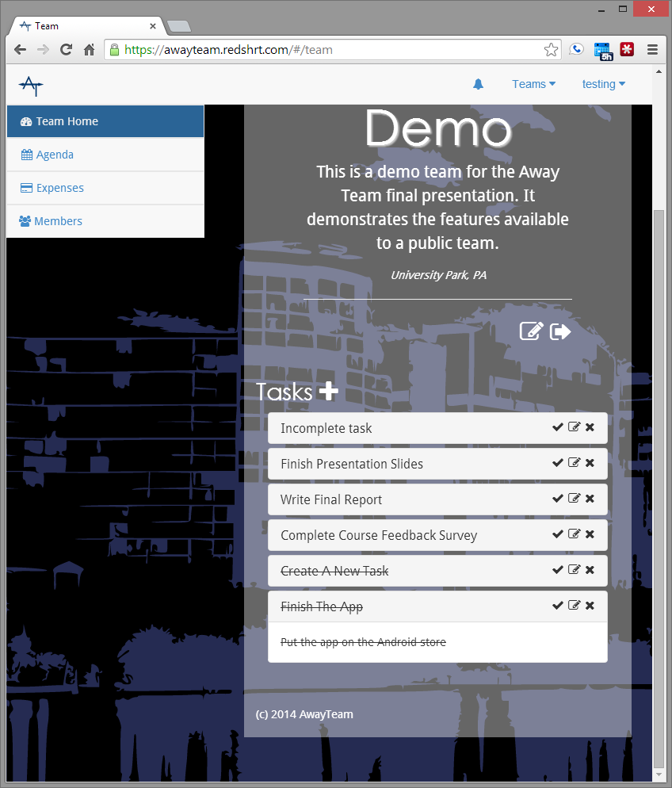
Features: Coordination Tools
Team Contacts
Find Team contact information in one place
Easy group contact options
Team Agenda
View scheduled events and details
Get directions using location
Team Tasks
Shared list of tasks to accomplish
Track progress on team goals
Notes:
Again, the web application has the same tools:
(click)
Members can be accessed along with a display of their most recent location.
(click)
The agenda view also shows the location on a map and the navigation link will open a full Google map view for directions and more details.
(click)
Tasks can be expanded to show more detail and are displayed as crossed out when complete.

Slide 14
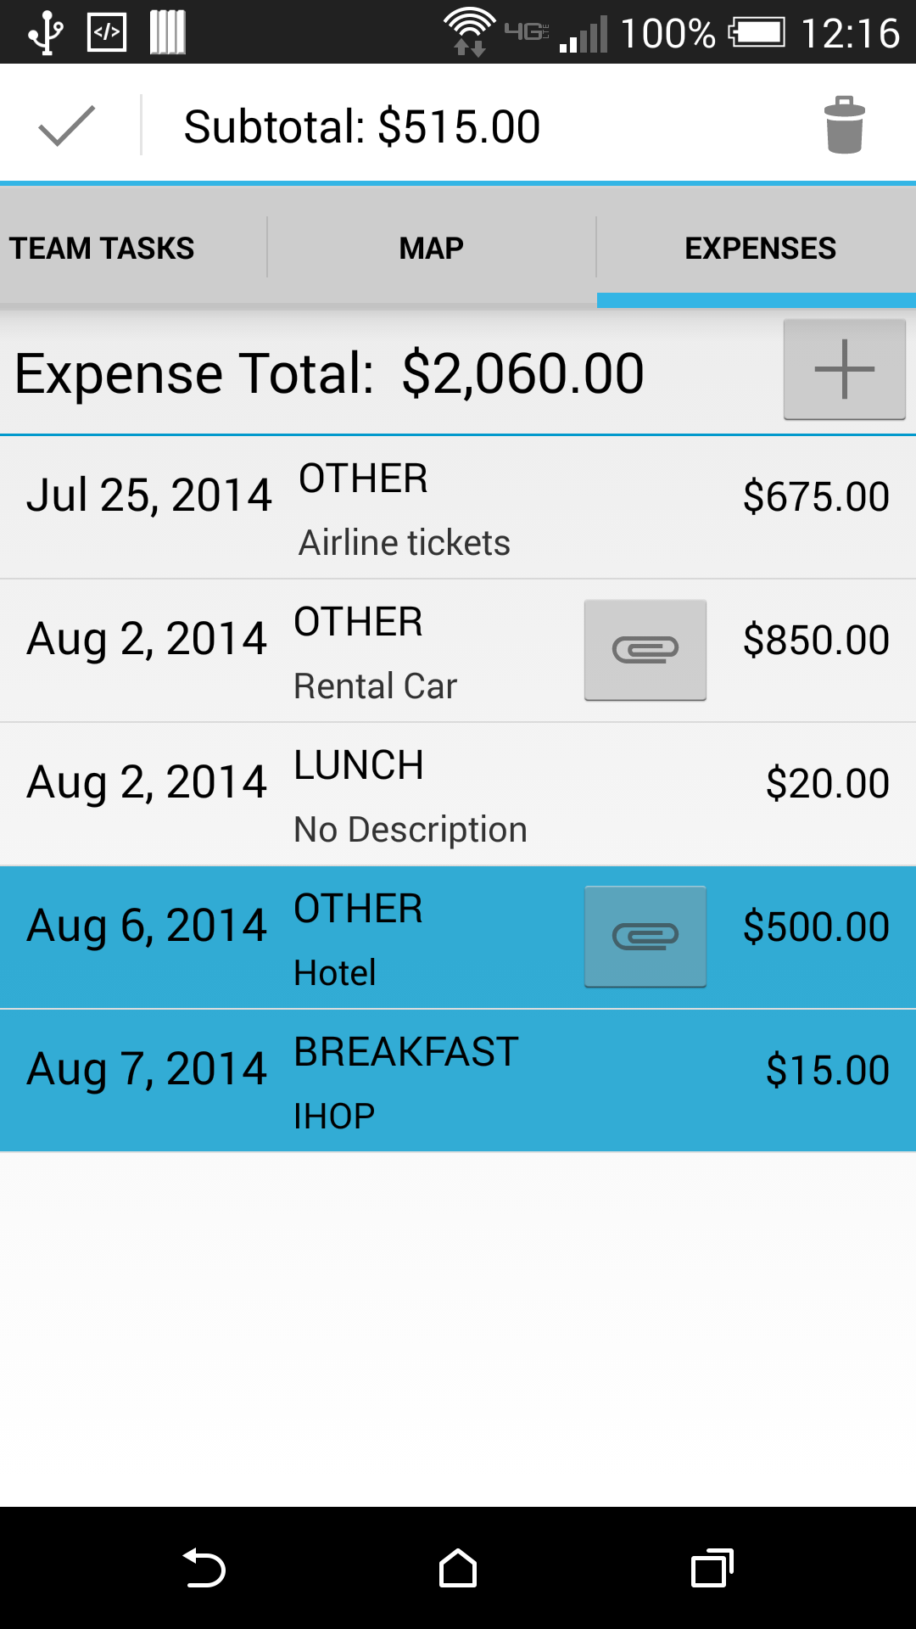
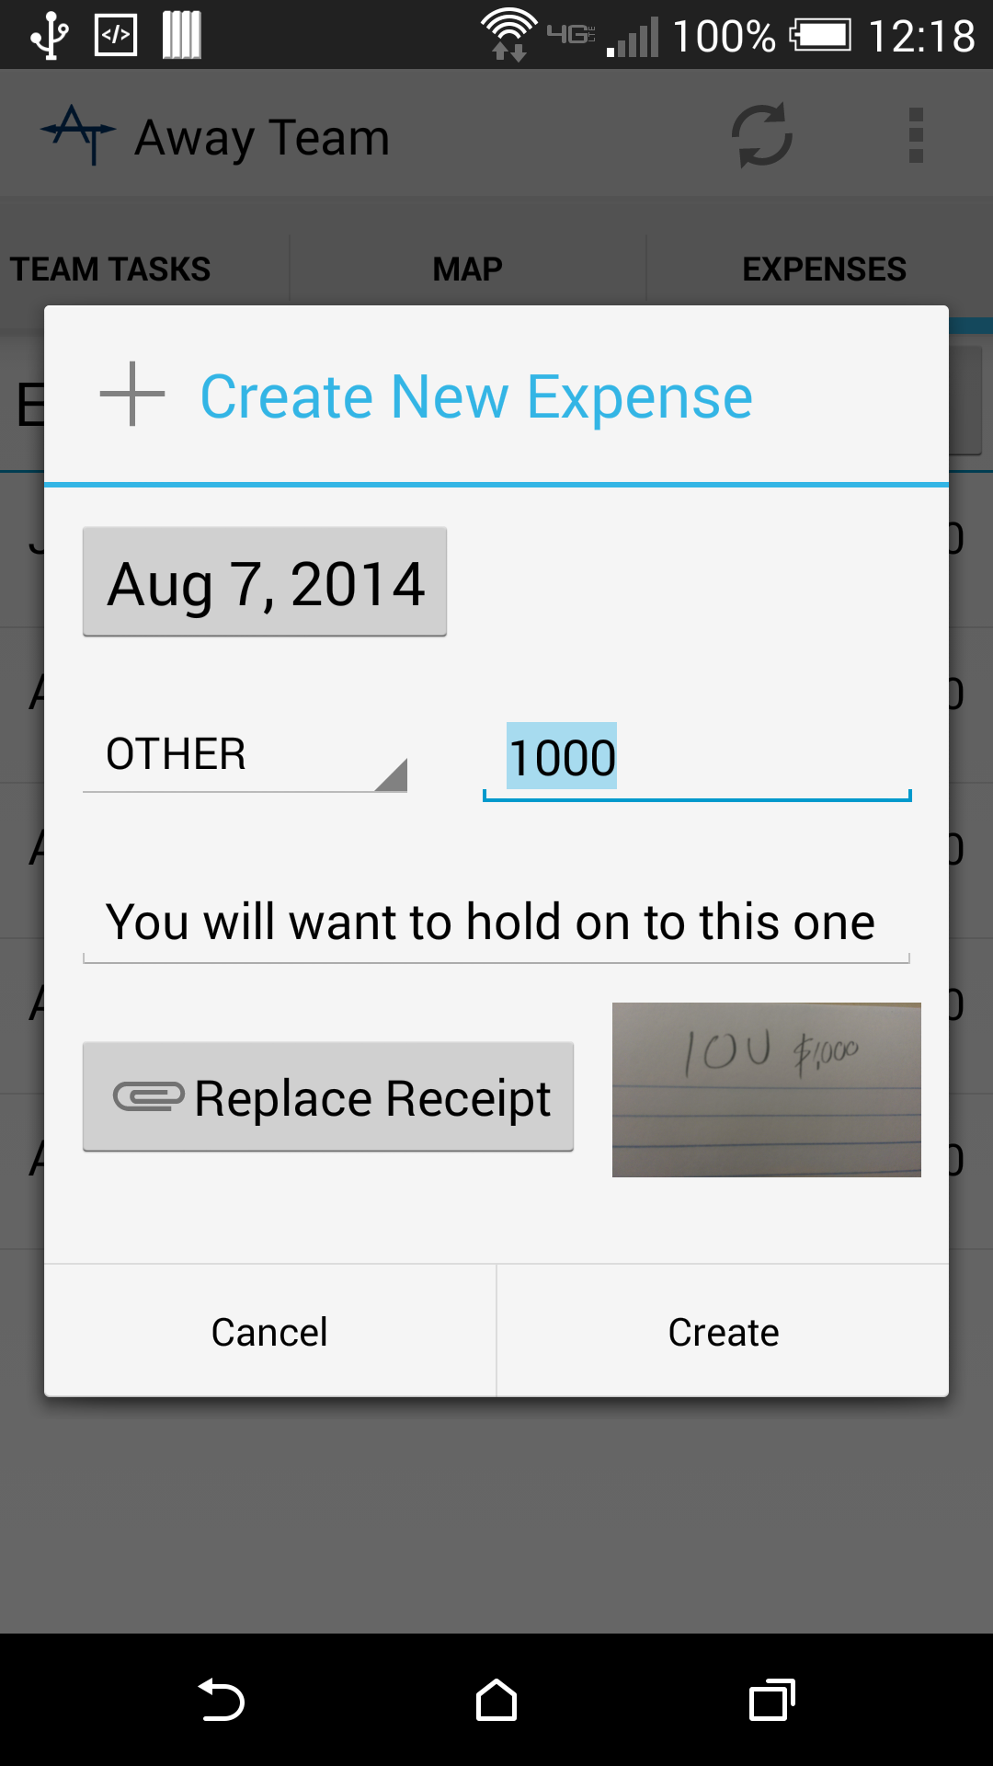
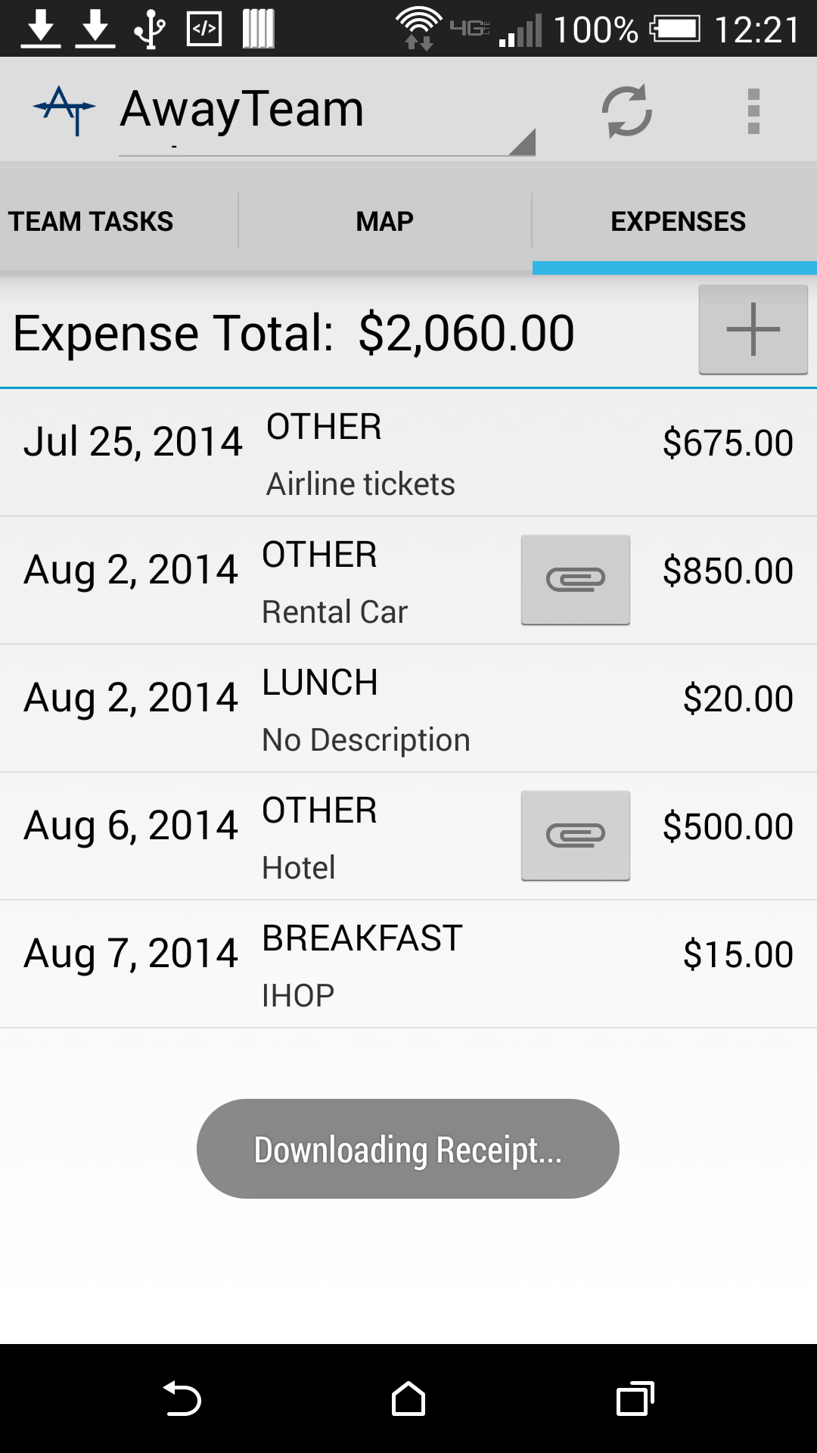
Features: Track Expenses
View Expense Totals and Subtotals
Select expenses to get a subtotal calculation
Take Receipt Pictures
Upload receipt images with your expenses
Preview shown after taken
Download Receipt Image
Click on the Attachment button to download image in background
Notes:
An additional feature is the ability to track expenses. Expenses are private and only the user that creates an expense can view them. This can be used to file expense reports after completing a work trip.
(click)
Expense totals are automatically calculated, and selecting multiple expenses will provide a subtotal of the selected amounts.
(click)
Expenses allow you to store a receipt for the expense. These image files can be taken directly with the camera or selected from a file.
(click)
Expenses with receipt images show the attachment button - clicking this will download the expense in the background - important for slower mobile connections where a hi-res receipt may take some time to download.

Slide 15
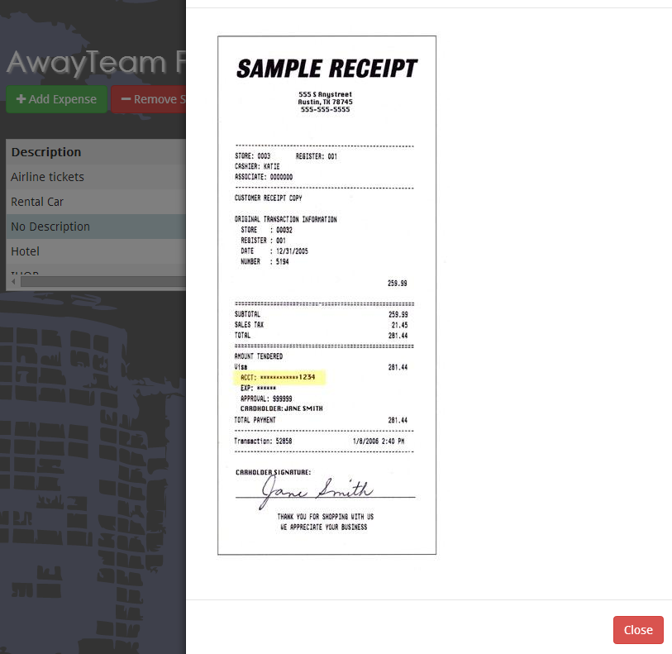
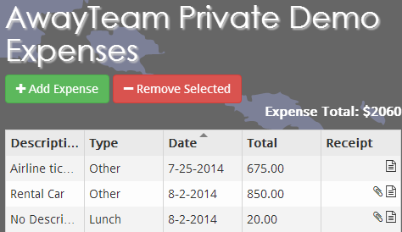
Features: Track Expenses
View Expense Totals
Total expenses calculation
Sort Table
Sort by any column
Upload Receipt Pictures
Upload receipt images with your expenses
View Receipt Image
Click on the Attachment button to view image
Notes:
The web client has similar expense features.
(click)
Expense totals are calculated at the top
(click)
The expenses in the table can be sorted by any column
(click)
Clicking the file image allows users to upload expense images. On mobile devices, taking a picture with the camera is offered as an option!
(click)
The attachment icon opens a convenient display of the receipt image.

Slide 16
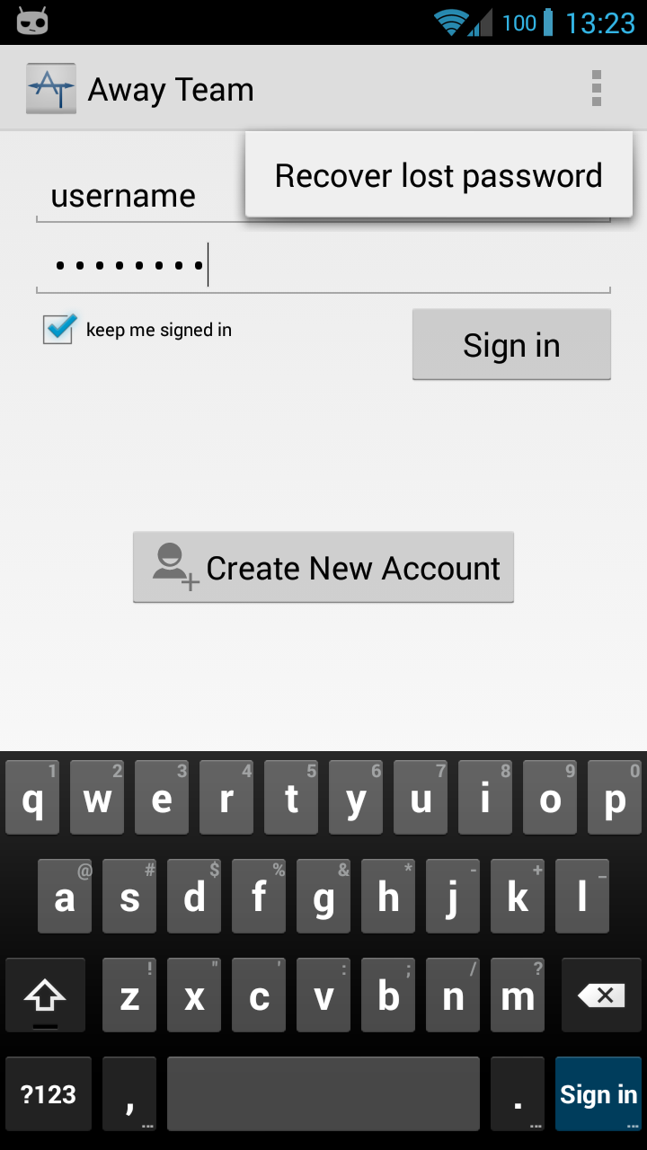
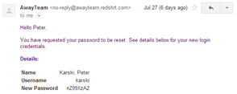
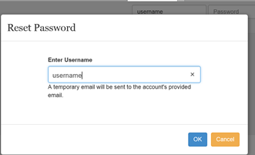
Security: Password Reset
username
Notes:
Although most of the security features are behind the scenes and invisible to the user, the password reset is a feature that allows the recovery of lost credentials without jeopordizing the authentication process.
When a user forgets their password, they can reset it using their login username. An email with a randomly generated replacement password is sent to them. After logging in with the temporary password, the user may change their password through the account tools.
REMEMBER TO DIRECT EVERYONE TO CLAYTON’S SCREEN FOR A DEMO OF THE WEB CLIENT

Slide 17
Web Client Demo

Slide 18
Android App Demo

Slide 19
Questions
?

